Slide 1
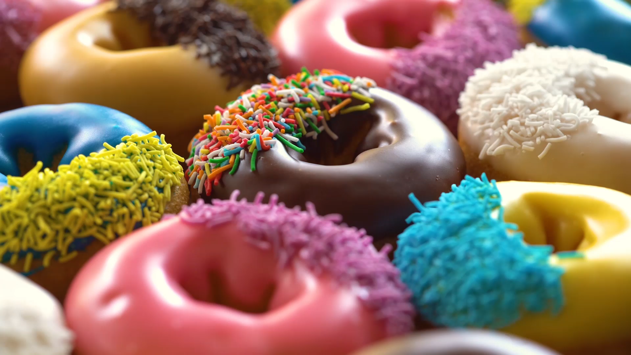
Random Number Generators
Marnix Laar & Camiel Verdult

Slide 2
Contents
Randomness
Random number generation methods
Random number engines in <random>
Cryptographically strong Random number generation
Hardware random number generation
Notes:
Marnix

Slide 3
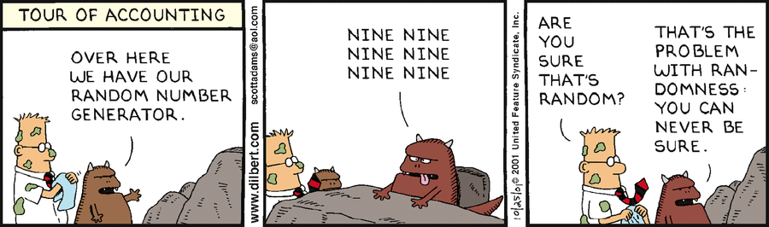
Randomness
Notes:
Camiel

Slide 4
Pseudo randomness
Random number engines use a seed as entropy data source
Notes:
Camiel

Slide 5
Pseudo random? What does that mean?
pseudo
adjective
pseu·​do
Definition of pseudo
: being apparently rather than as stated
Notes:
Camiel

Slide 6
Entropy?
Entropy is the measure of the level of order or the level of information.
Notes:
Marnix

Slide 7
Seed?
Value as a starting value for generating random numbers
Timestamp
Floating pin value
Temperature
Notes:
Marnix

Slide 8
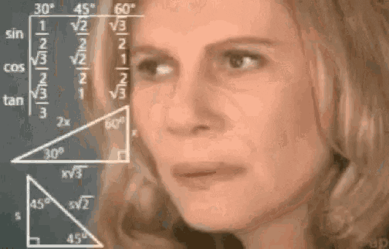
Random number generation engines (trigger warning: math)
Notes:
Marnix

Slide 9
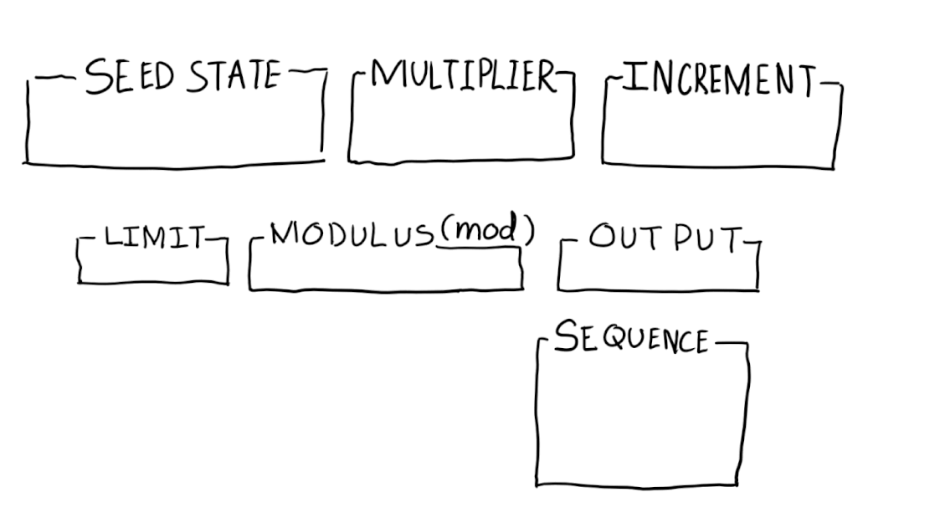
Linear Congruential
Xn+1 = (a * Xn + c) % m
Notes:
Camiel

Slide 10
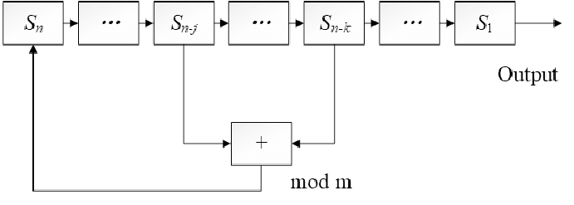
Lagged Fibonacci
x(i) = (x(i - S) - x(i - R) - cy(i - 1)) % W where cy = 1 if x(i - S) - x(i - R) - cy(i - 1) < 0 else 0
Notes:
Camiel

Slide 11
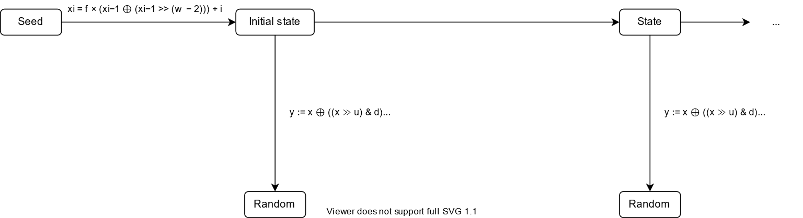
Mersenne Twister
Seed → Initialize → State → Twist
Notes:
Camiel

Slide 12

It’s not actually random.
That’s sad.
Notes:
Marnix

Slide 13
OK, why use them?
Spectral characteristics make the values appear random
Very useful for “unsecure” scenarios like games, simulations & tests
Notes:
Camiel

Slide 14

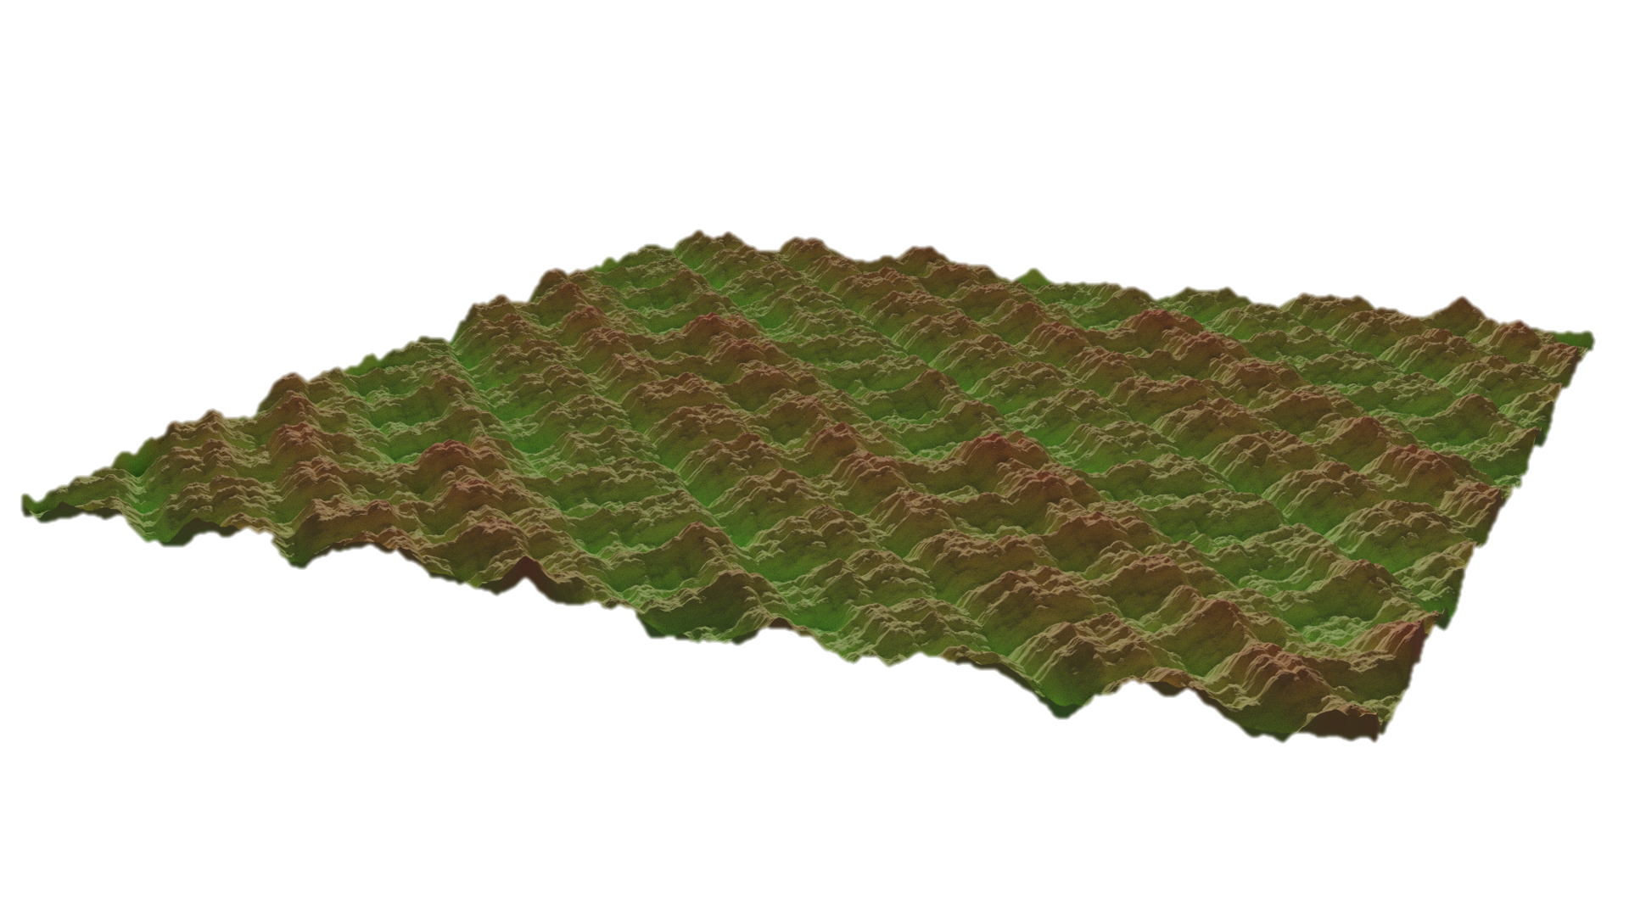
Gradient noise
Linear congruential
Subtract with carry
Std::rand()
Mersenne twister
Notes:
Marnix

Slide 15


Gradient noise
Linear congruential
Subtract with carry
Std::rand()
Mersenne twister
Notes:
Marnix

Slide 16
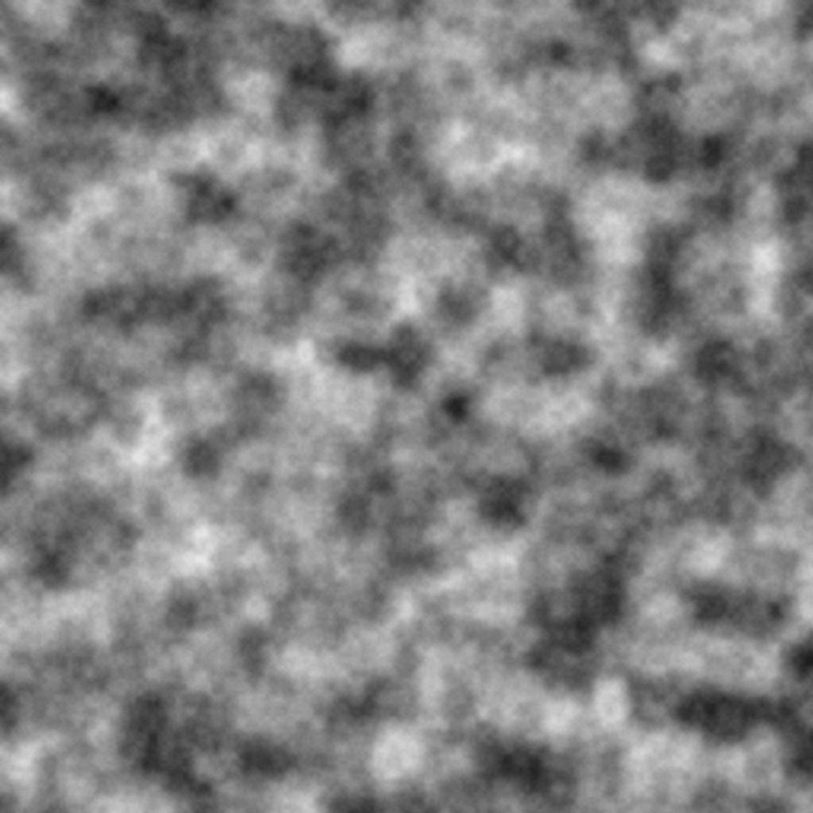
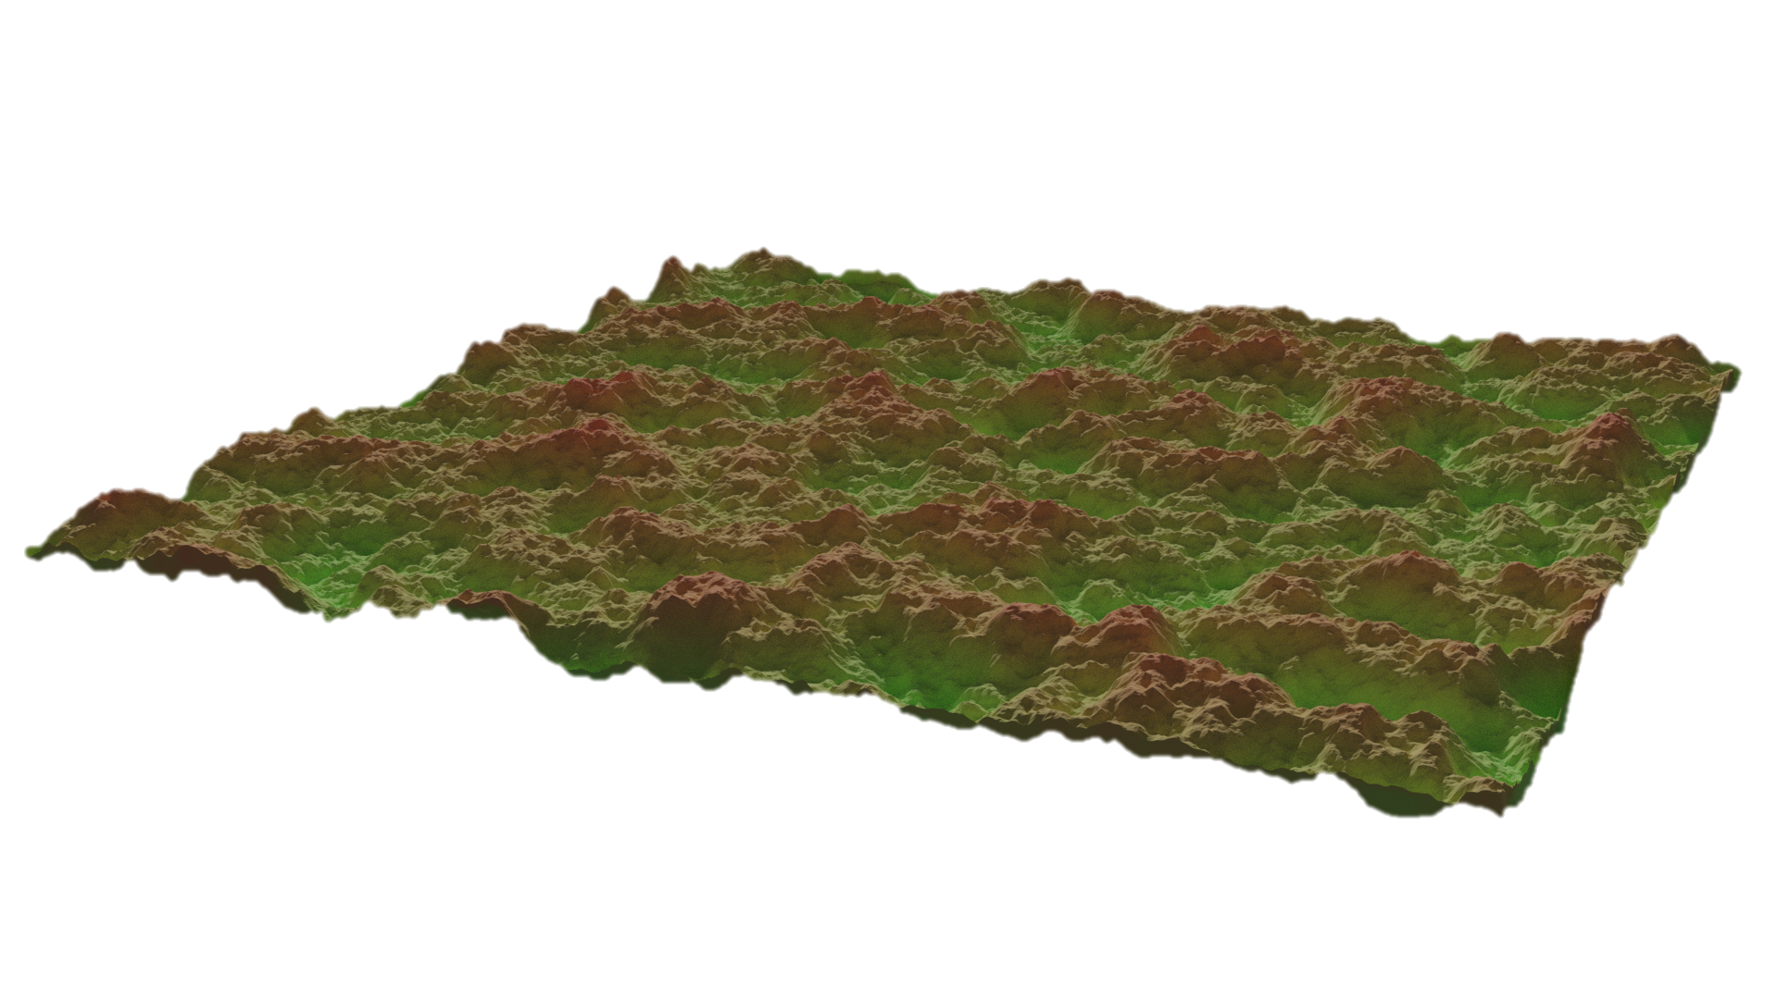
Gradient noise
Linear congruential
Subtract with carry
Std::rand()
Mersenne twister
Notes:
Marnix

Slide 17
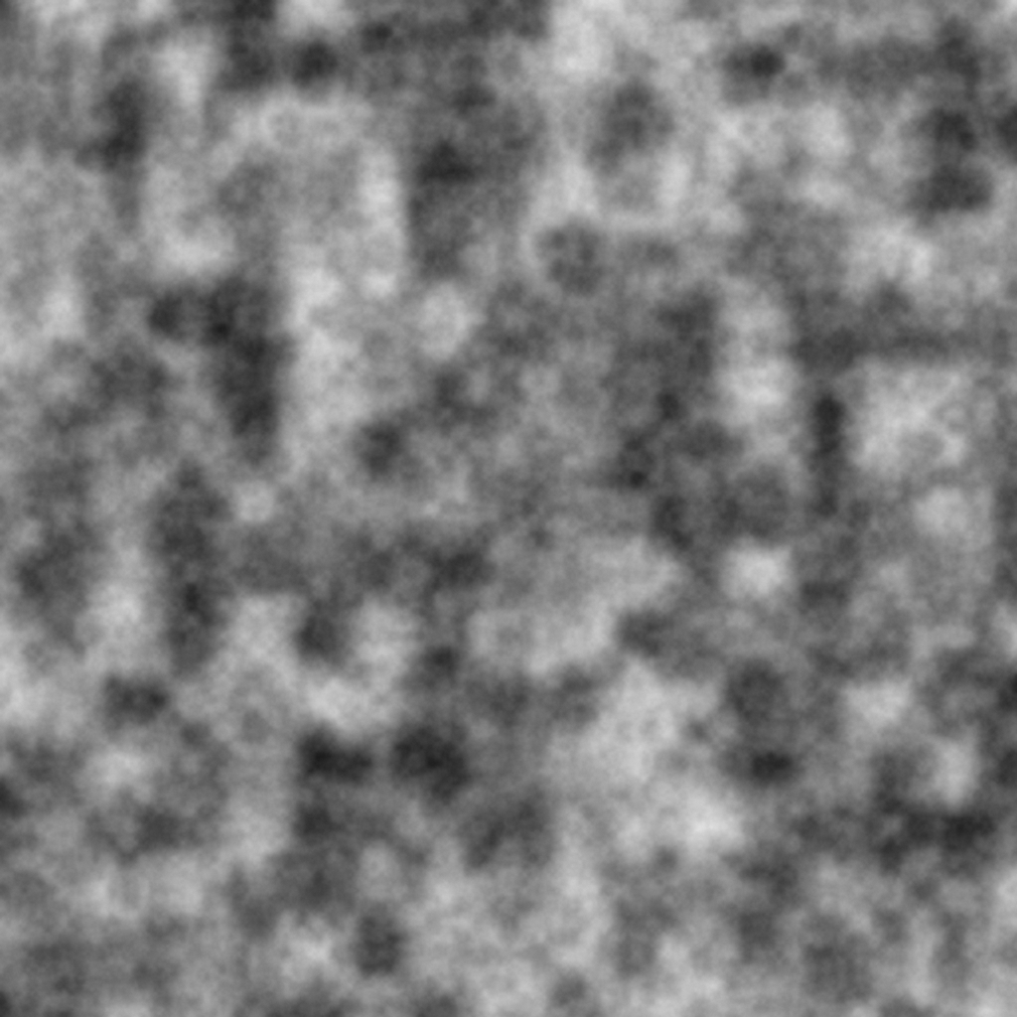
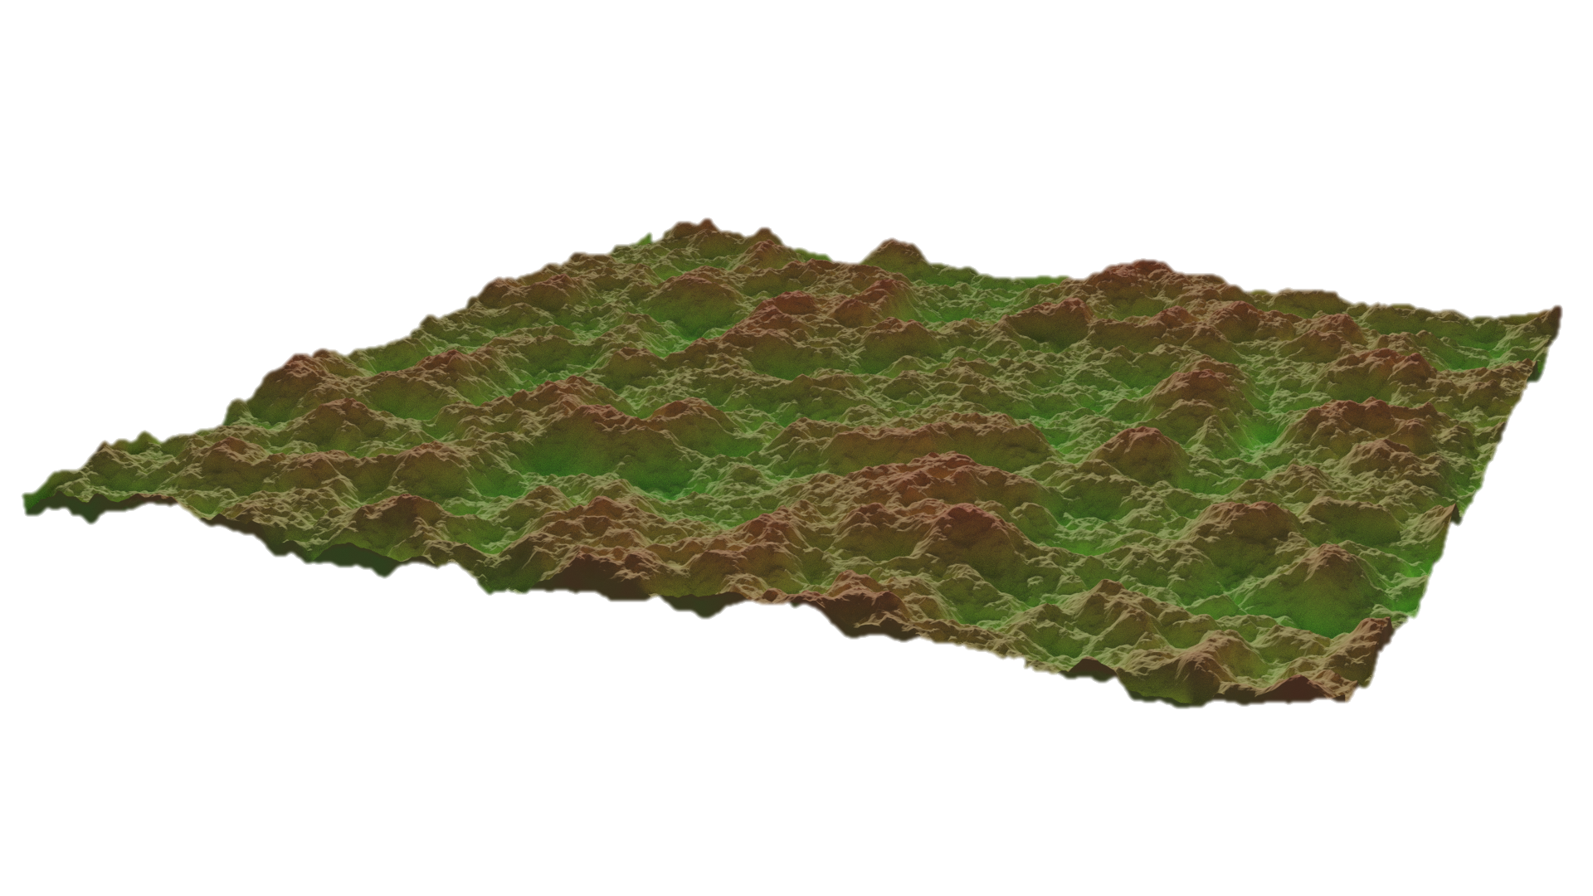
Gradient noise
Linear congruential
Subtract with carry
Std::rand()
Mersenne twister
Notes:
Marnix

Slide 18
That’s cool and all
But what more can we do?
Notes:
Camiel

Slide 19
Use cases where pseudo random is just not enough
Really big games or simulation with less-than-ideal settings (short period)
Generating unique and unguessable numbers (encryption)
Gambling (which must be random, otherwise online casinos would be bankrupt)
Notes:
Marnix

Slide 20
Well, how do we get random numbers that are truly random?
Notes:
Camiel

Slide 21
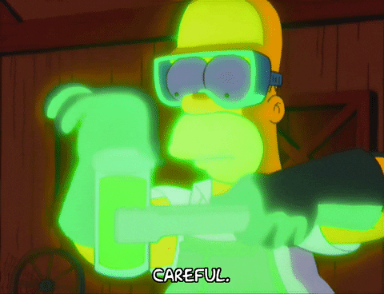
Short answer:
You use a Cryptographically secure random number generator OR
You use a naturally random source (like radioactive decay)
Notes:
Marnix

Slide 22
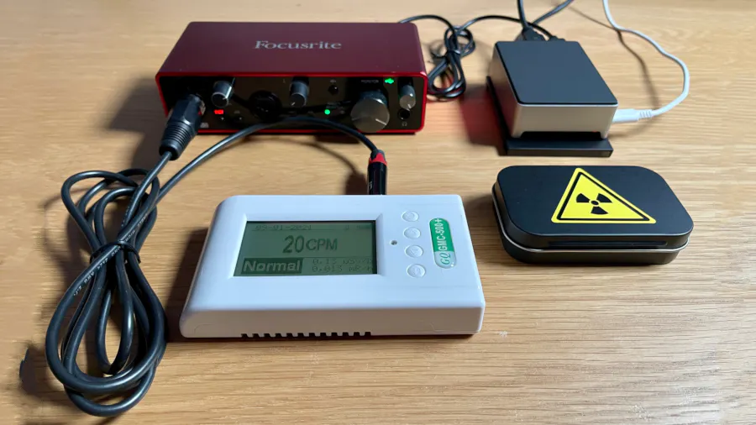

Slide 23
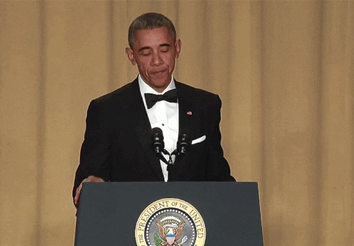
All done
Y’all good?

